Slide 1
Indian Institute of Information Technology Una
Code Quest - Coding Exam Website for IIITUna
By:
Vansh Verma
23165
B.Tech. CSE (4rd Sem.)

Slide 2
Outline
01
Introduction
02
Motivation
03
Project Architecture
04
Innovation in the Project
05
Literature Review/
Currently available
solutions
06
Work Progress and Demonstration

Slide 3
01
Introduction

Slide 4
1. Introduction
Have you ever been in an invigilation duty in a computer practical exam???
It is too tiring for the teacher to check the code for each test case for each student and students have to wait a long time for their code to be checked.
It is quite easy to cheat with the online compiler.
Offline compilers are very unreliable
So here is my project which solves all these problems for both the parties.

Slide 5
02
Motivation

Slide 6
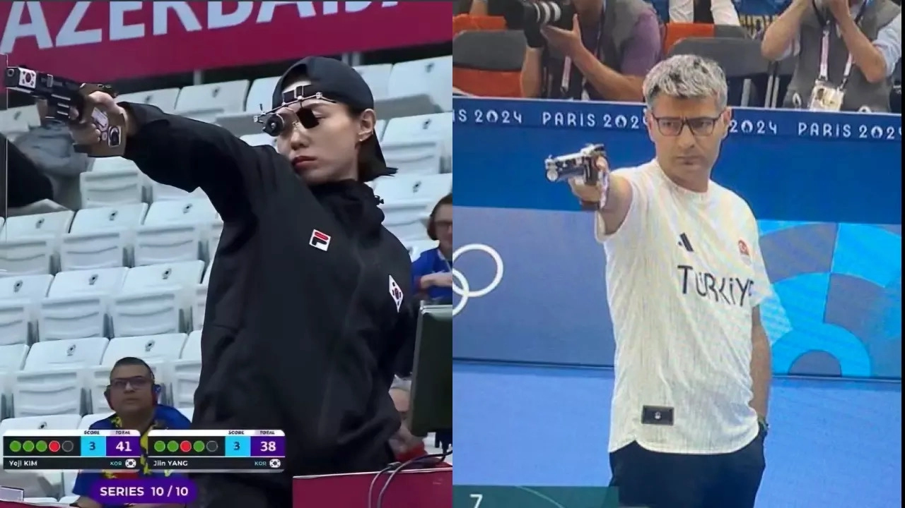
2. Motivation
Using 2 invigilators, online compilers, tiring checking process
Using Arpit’s Practicum project
Computer Practical Exams have been an issue due to offline compilers being unreliable and it is impossible to prevent cheating in the online compiler mode.
We need a better automatic proctored exam taking system
It takes too much time for the teacher to check each and every program while we can do that automatically and generate a leaderboard.

Slide 7
03
Project Architecture

Slide 8
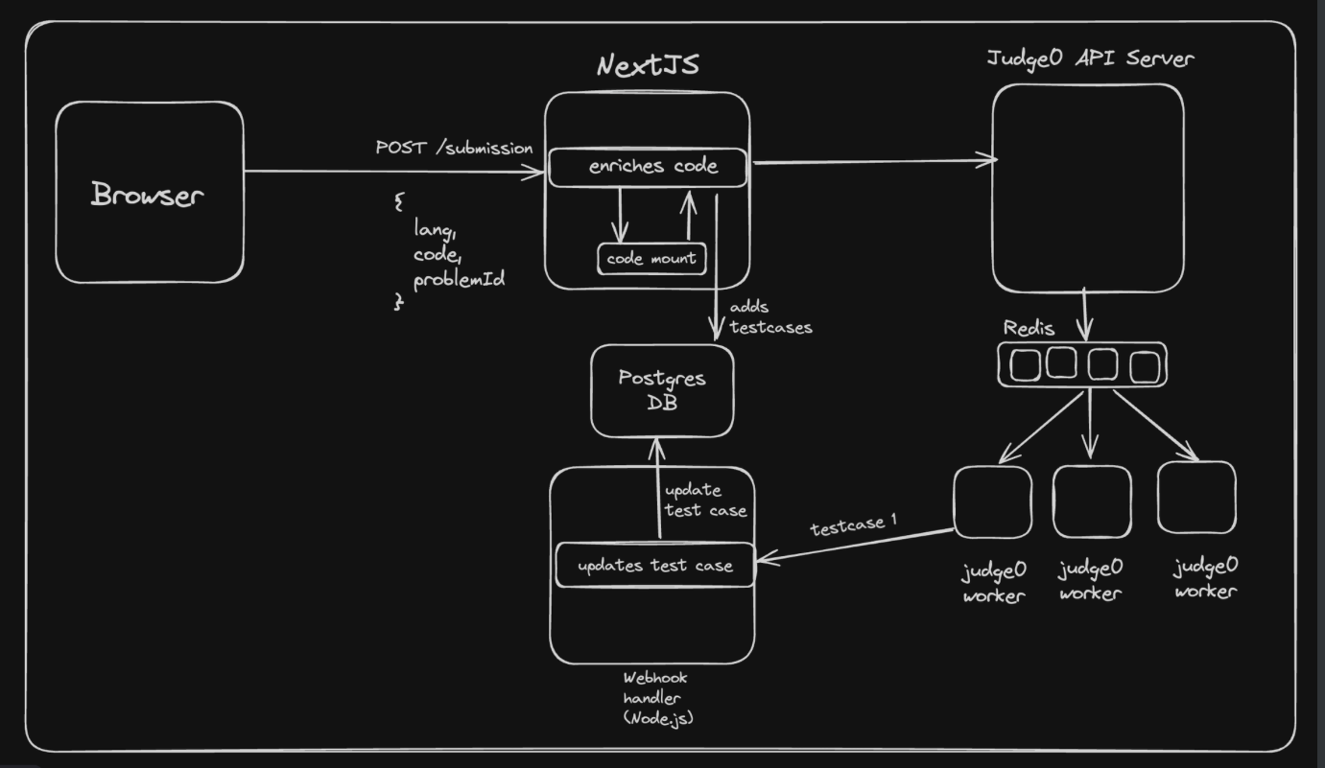
3. Project Architecture (System Design)

Slide 9
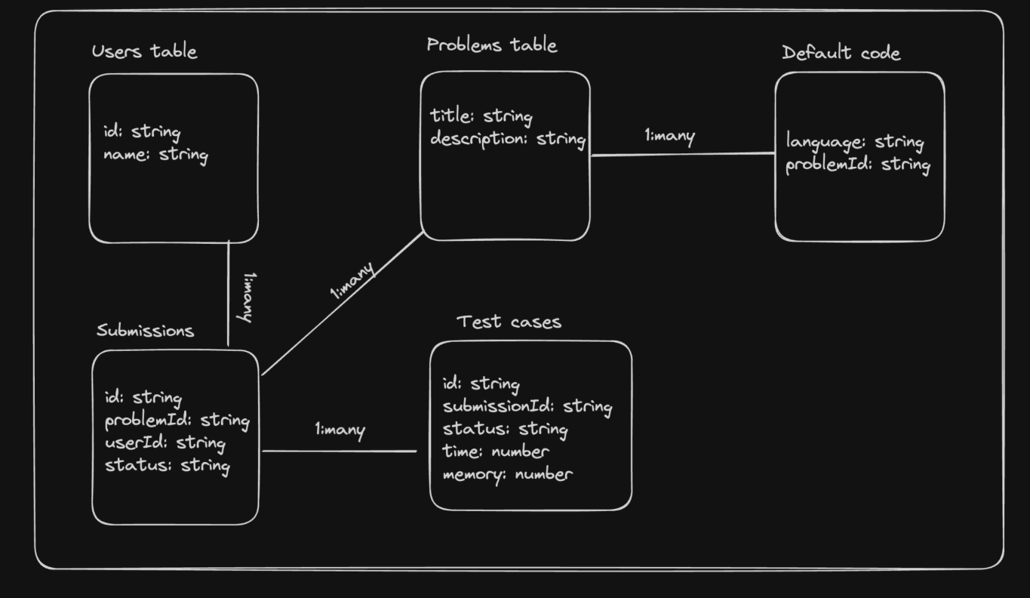
3. Project Architecture (Database Design)

Slide 10
04
Innovation in the Project

Slide 11
4. Innovation in the Project
Using multiple computer’s computation power to do horizontal scaling.
Project evaluation using test case method.
Providing boiler plate code.
Has special Anti-cheating mechanisms which locks the test if the student tries to cheat.

Slide 12
05
Literature Review/
Currently available solutions

Slide 13
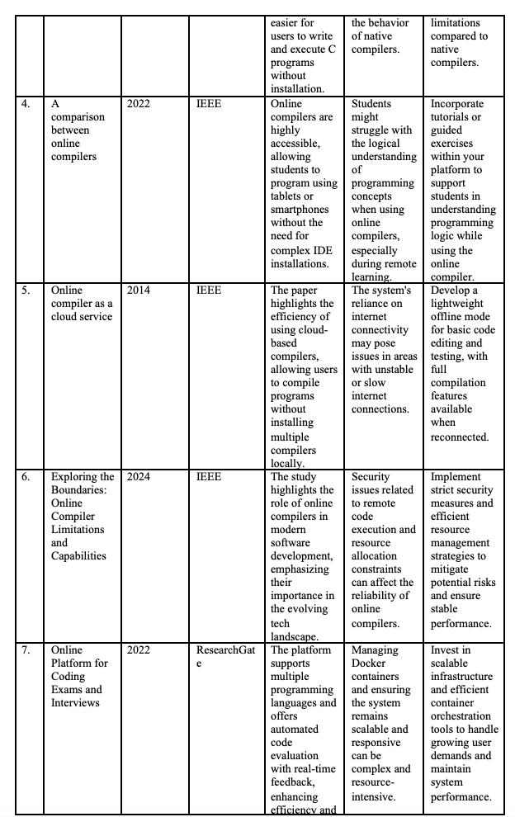
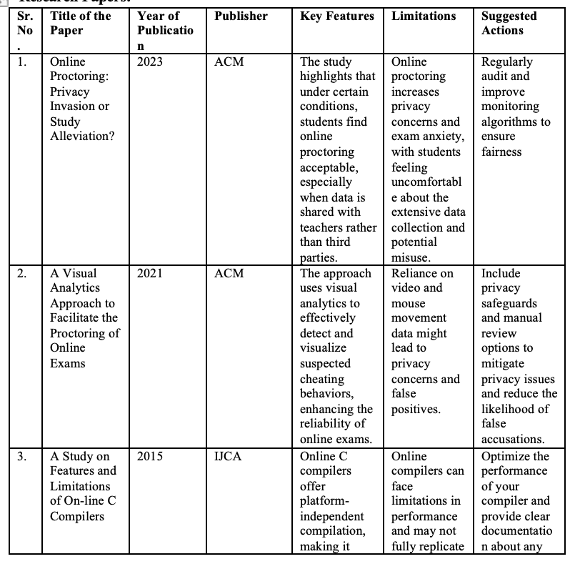
5. Literature Review/Currently available solutions

Slide 14
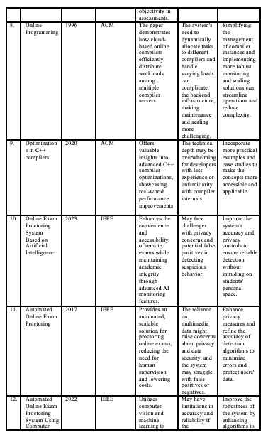
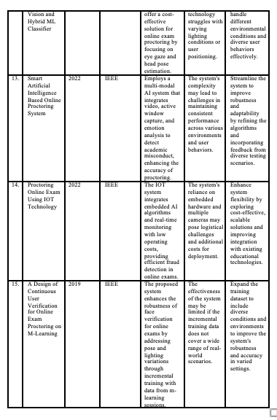
5.Literature Review/Currently available solutions

Slide 15

5.Literature Review/Currently available
solutions

Slide 16
06
Demonstration

Slide 17
6. Work Progress and Demonstration
https://code-compete.vercel.app/

Slide 18
Thanks! Questions and Answers
Contact Details:
Vansh Verma
23165@iiitu.ac.in
8791590991

